Slide 1


Our MFT Strategy 2024-29

Slide 2
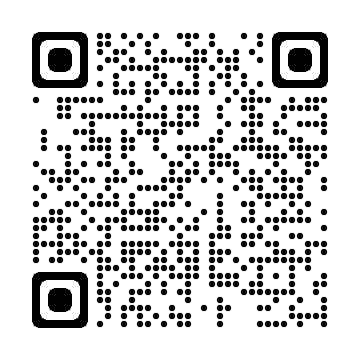

Follow this QR code to the MFT website where you can find our strategy

Slide 3


Slide 4
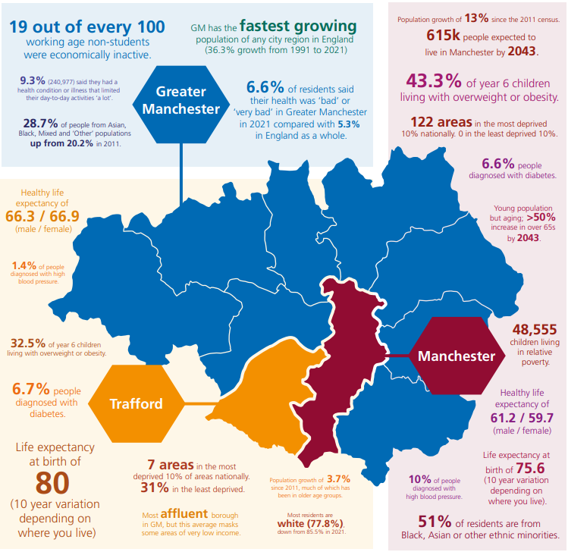

Slide 5
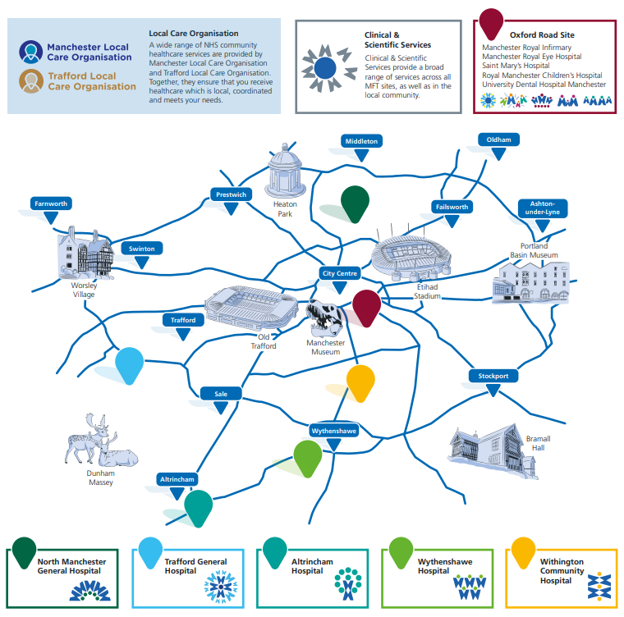

Slide 6



Slide 7






1
2
3
4
5
Text
Text
Text
Text

Slide 8













Slide 9
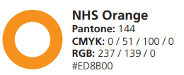
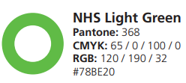







Purple
R:80 G:69 B:150
CMYK – 82 80 0 0
Hex code: #504596

Slide 10
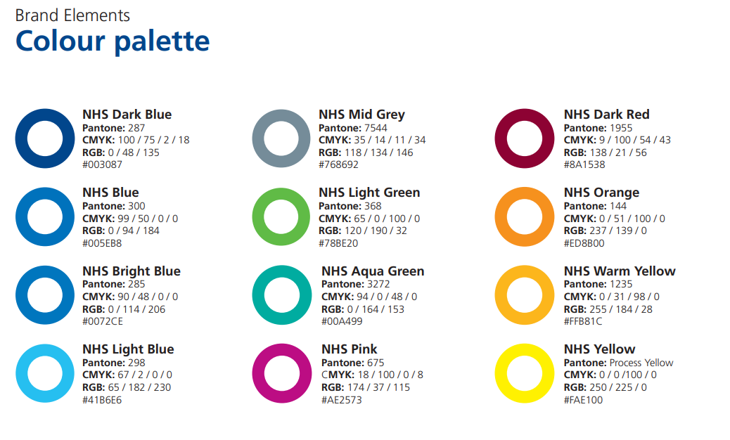

Slide 11


Slide 12


