Slide 1
Welcome
to team CSS!

Slide 2


Slide 3

Why am I doing a separate CSS induction?

Slide 4
Today
How does Clinical and Scientific Services (CSS) fit into Manchester University Hospitals NHS Foundation Trust (MFT)?
Snapshot of Manchester’s health and social care system
MFT vision and values​
Introduction to CSS​
Our divisions​
CSS services​
How we can support you
Staff benefits​

Slide 5
Acronyms
CSS - Clinical and Scientific Services fit into
MFT (or Group) - Manchester University Hospitals NHS Foundation Trust
NMGH – North Manchester General Hospital
WTWA – Wythenshawe, Trafford, Withington and Altringham
ACCP – Anaesthetics, critical care and perioperative medicine
IPCTV – Infection prevention control and tissue viability

Slide 6
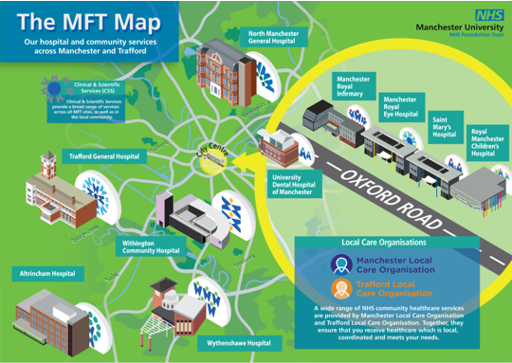

Slide 7
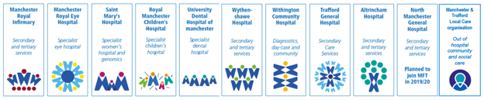
The breadth of CSS
We work across every site!

Slide 8
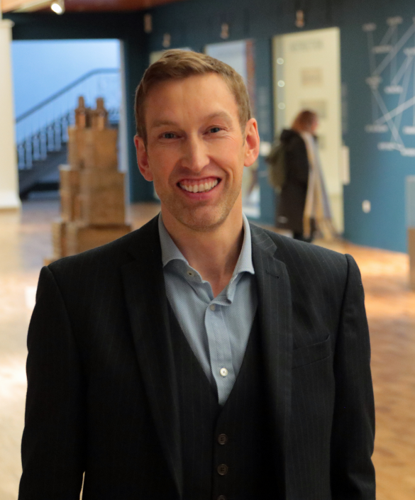
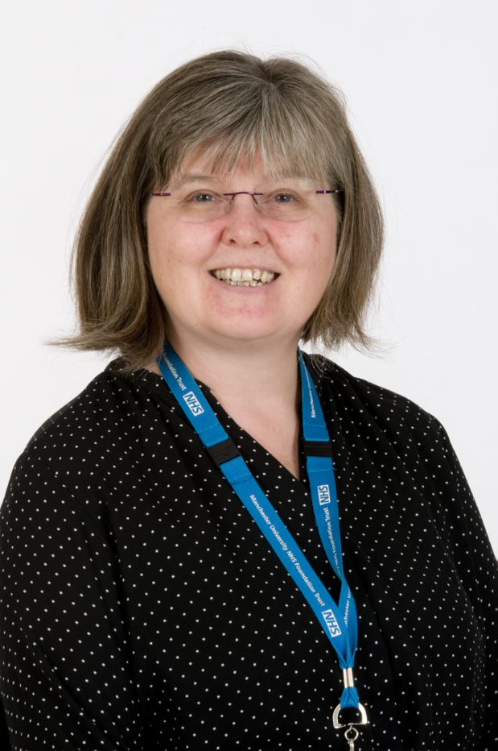
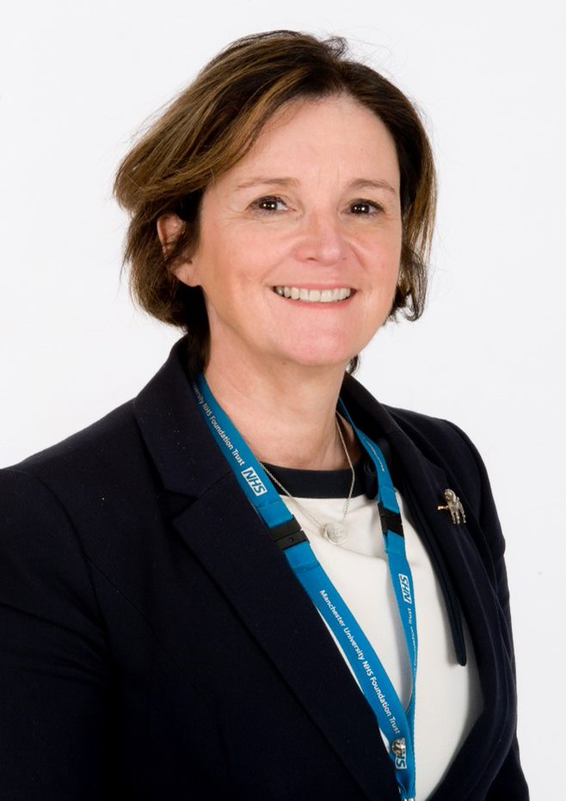
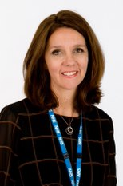
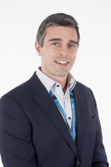
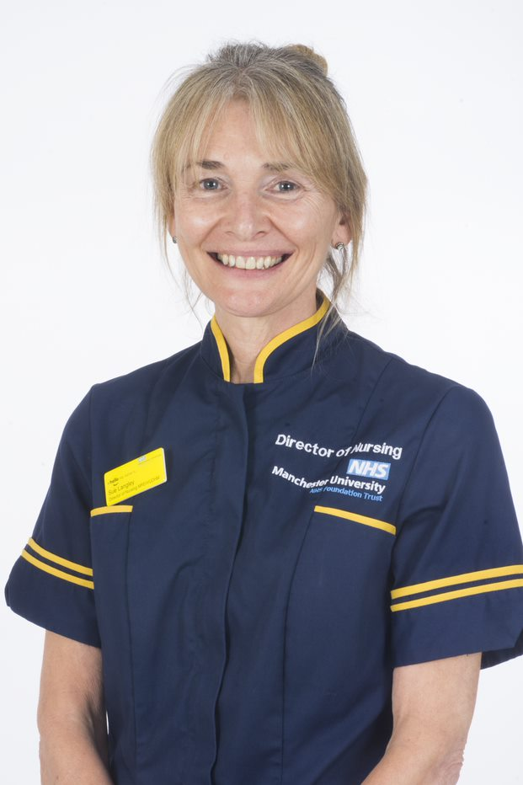
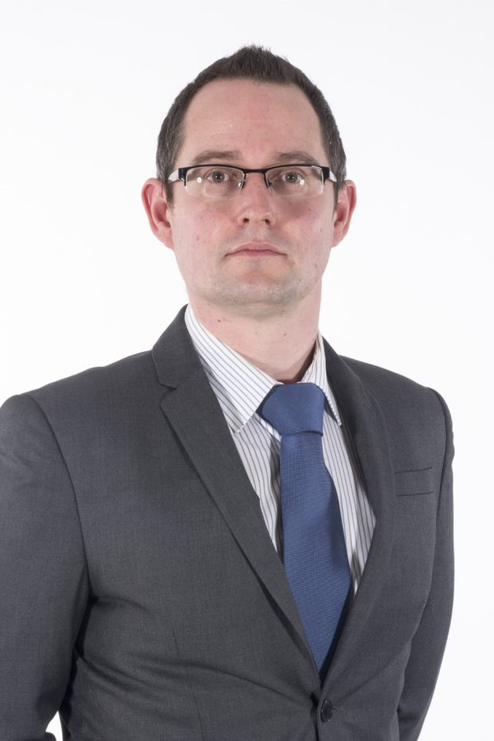
Our leadership team
Tim Keeler
Chief Executive Officer
Zara Pain
Deputy Chief Executive
Director of HR & OD
Sarah O’Shea
Medical Director
Charlotte Skitterall
Group Chief Pharmacist
Gareth Adams
Director of Operations
Sue Langley
Director of Nursing & Healthcare Professions
Chris Evans
Director of Finance

Slide 9
CSS Divisions

Slide 10



Critical care,
anaesthetics and
perioperative care
Allied health professionals
Corporate services and IPCTV *
Imaging
Pharmacy
Laboratory medicine
* IPCTV - Infection, prevention and control and tissue viability

Slide 11
Critical care,
anaesthetics and
perioperative care
Allied health professionals
Corporate services and IPCTV *
Imaging
Pharmacy
Laboratory medicine
* IPCTV - Infection, prevention and control and tissue viability

Slide 12
Allied Health Professionals
(AHPs)

Slide 13
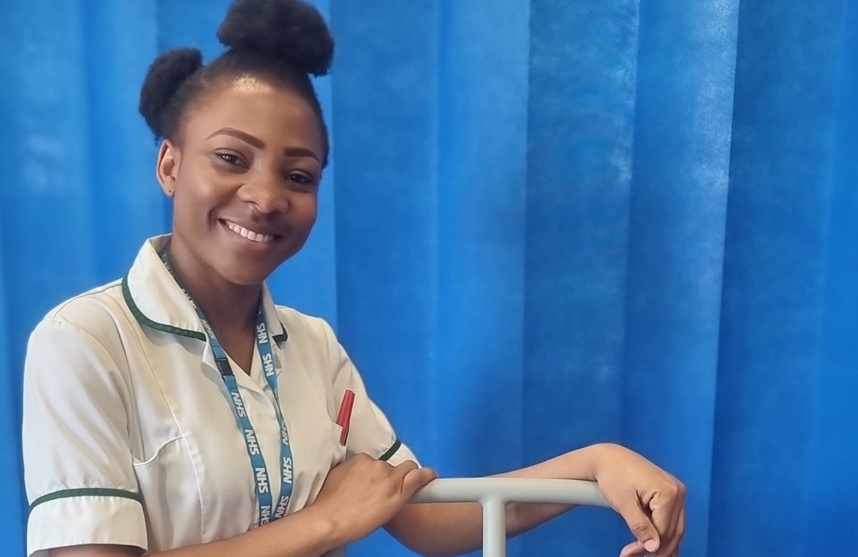
Allied Health Professionals
(AHPs)

Slide 14




Physiotherapists
Occupational therapists
Podiatrists
Dieticians

Slide 15




Speech and language therapists
Prosthetics
Audiology and hearing specialists
Orthototics

Slide 16
Anaesthetics,
Critical Care and Perioperative Medicine

Slide 17
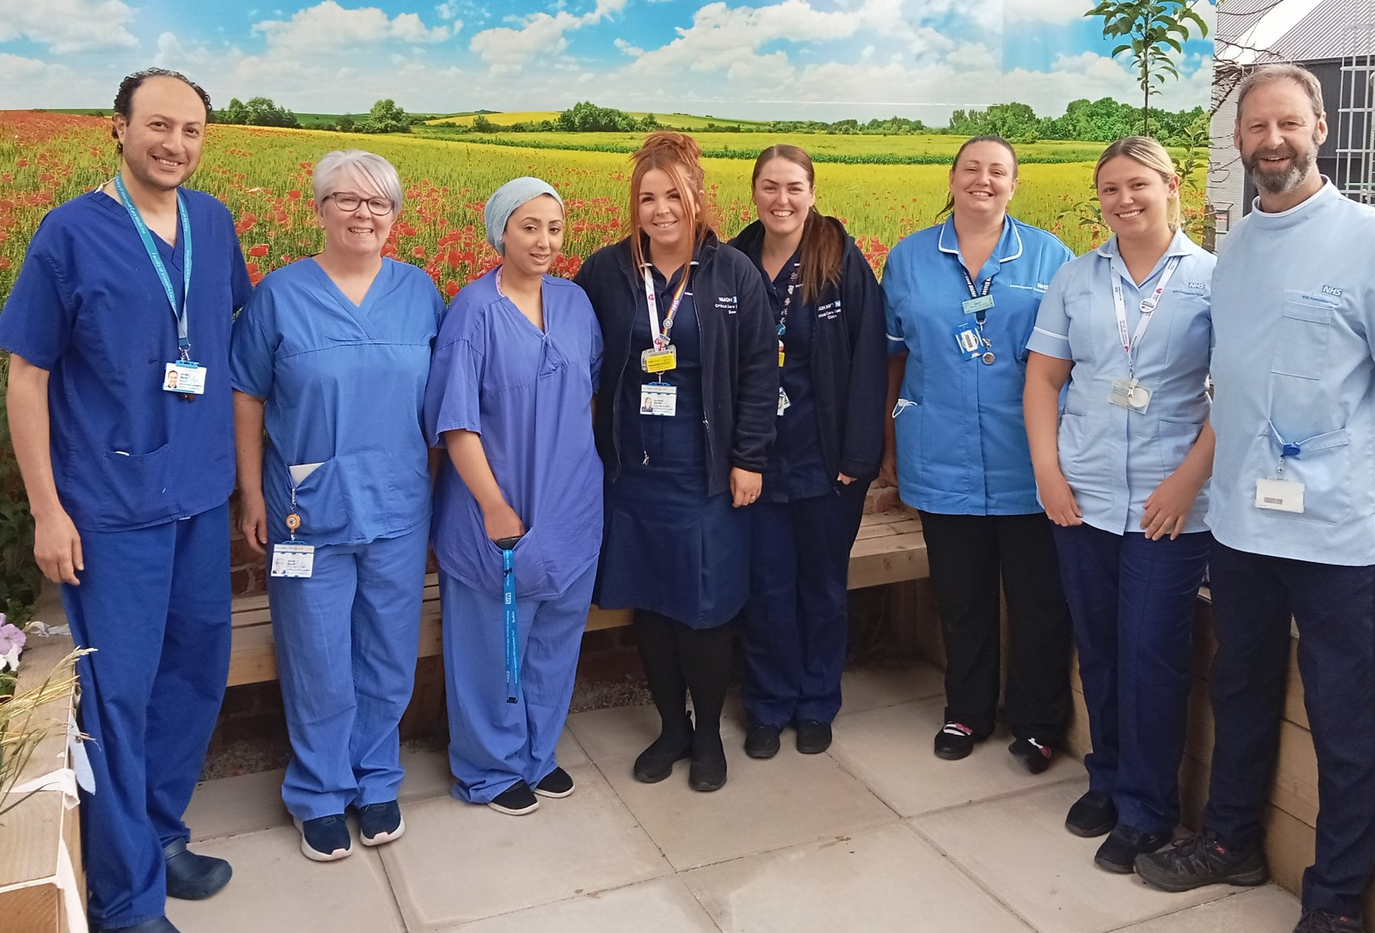
Anaesthetics,
Critical Care and Perioperative Medicine

Slide 18
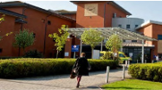
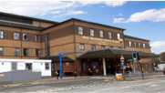
CTCCU at Wythenshawe
31-bed specialist area
Hosting the regional ECMO service for the north of England
AICU at Wythenshawe
17 beds - specialising in respiratory patients
Includes post-ECMO patients and CTCCU patients
North Manchester General Hospital critical care
12 beds looking after critically-ill patients​

Slide 19
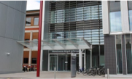
Adult Critical Care – MRI
20 beds
Operates with a 1:1 staff ratio
Additional 20 high-dependency unit beds​
Cardiac Surgery Intensive Therapy Unit - MRI
Eight level 3 beds
Four level 2 beds​
Enhanced Care Unit – MRI
Eight level 2 beds caring for over 20 patients per week​
Innovators of enhanced recovery after surgery plus (ERAS +)​

Slide 20
Imaging

Slide 21
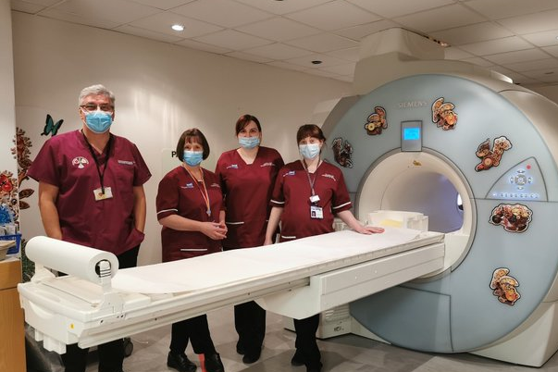
Imaging

Slide 23
Laboratory
Medicine

Slide 24

Laboratory
Medicine

Slide 25
Laboratory Medicine teams
Infectious Sciences (Microbiology, Virology and Mycology)
Immunology
Biochemistry
Cellular Pathology
Haematology

Slide 26
Laboratory Medicine
One of the largest pathology services in the UK​
Regional centre for haemophilia diagnosis and treatment
The immunology department was the first in the UK to install multiplex testing platforms, dramatically reducing turnaround times
The mycology team was the first in the world to be accredited by the European Confederation of Medical Mycology as a centre of excellence

Slide 27
Pharmacy

Slide 28
Pharmacy
Workforce Innovator of the Year nomination​​
Vaccine clinic rollout​
Click and collect service​
Apprentice development up to level 6​
Outpatient home delivery service​
Gene therapy​
Recent achievements!

Slide 29
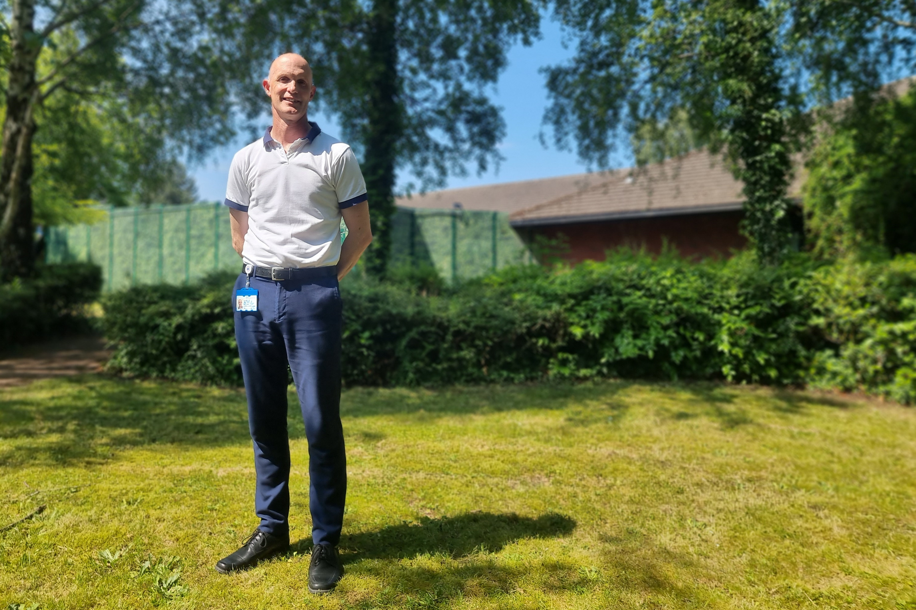
Pharmacy

Slide 30
Corporate services and IPCTV

Slide 31
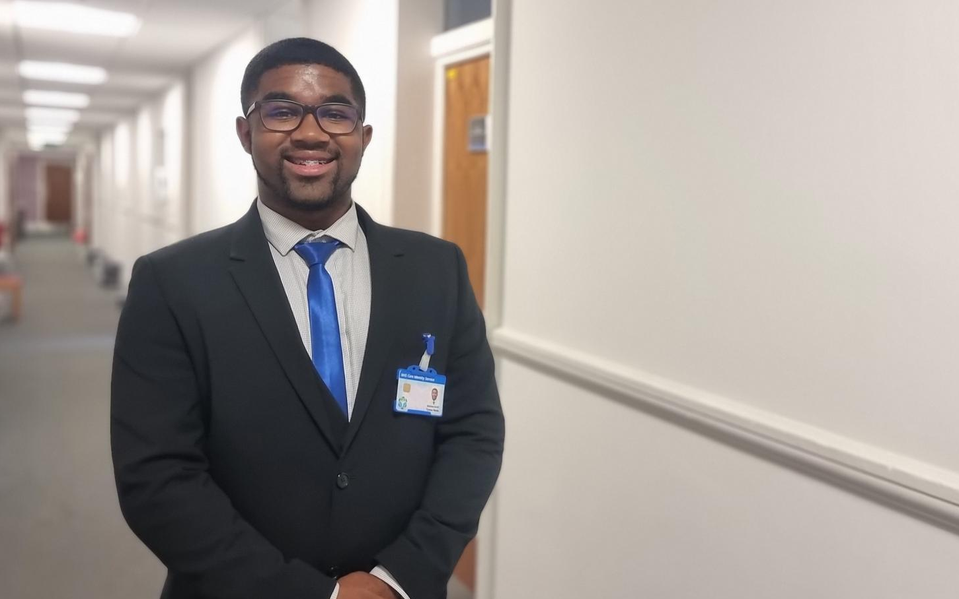
Corporate
services
and IPCTV

Slide 32
Corporate Services and
Infection Prevention Control and Tissue Viability
Finance
HR
Transformation
Operations
IPCTV

Slide 33
Quiz

Slide 34
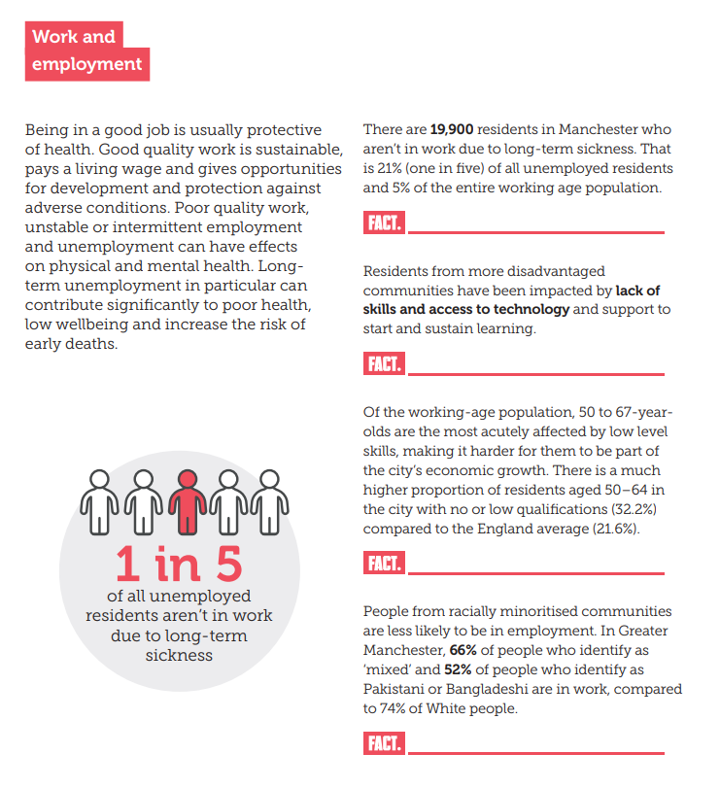
Work and employment in Manchester
Notes:
Being in a good job is usually protective of health. Good quality work is sustainable, pays a living wage and gives opportunities for development and protection against adverse conditions.
Poor quality work, unstable or intermittent employment and unemployment can have effects on physical and mental health.
Long term unemployment in particular can contribute significantly to poor health, low wellbeing and increase the risk of early deaths.

Slide 35
Work and employment in Manchester
Notes:
Being in a good job is usually protective of health. Good quality work is sustainable, pays a living wage and gives opportunities for development and protection against adverse conditions.
Poor quality work, unstable or intermittent employment and unemployment can have effects on physical and mental health.
Long term unemployment in particular can contribute significantly to poor health, low wellbeing and increase the risk of early deaths.

Slide 36
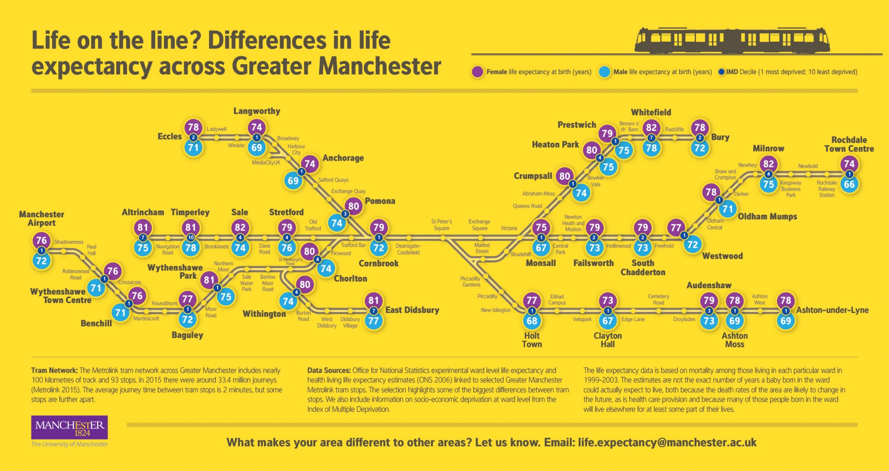

Slide 38
Break

Slide 39
Vision and values

Slide 40



Organisational visions
“to entertain, inform and inspire people around the globe through the power of unparalleled storytelling, reflecting the iconic brands, creative minds and innovative technologies that make ours the world's premier entertainment company.”
“to be earth’s most customer-centric company, where customers can find and discover anything they might want to buy online”
To grow a profitable airline, that people love to fly and where people love to work.”

Slide 41
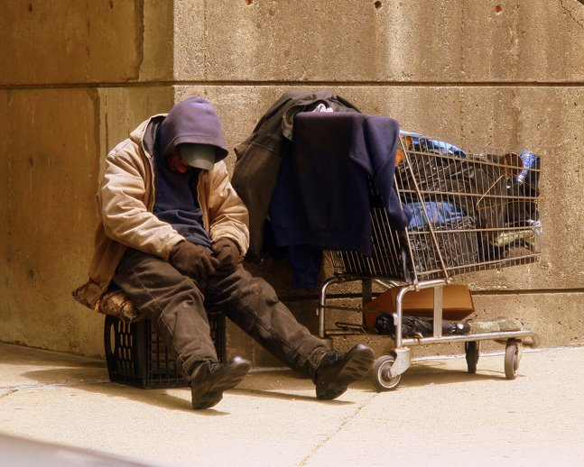
Understanding your values
Would you give this person a sandwich?
Yes or no?

Slide 42


Slide 43


Slide 44
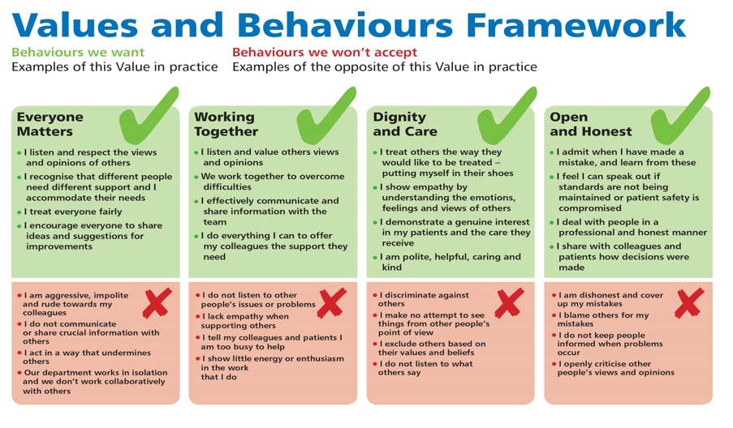

Slide 45
Everyone matters

Slide 46


Slide 47
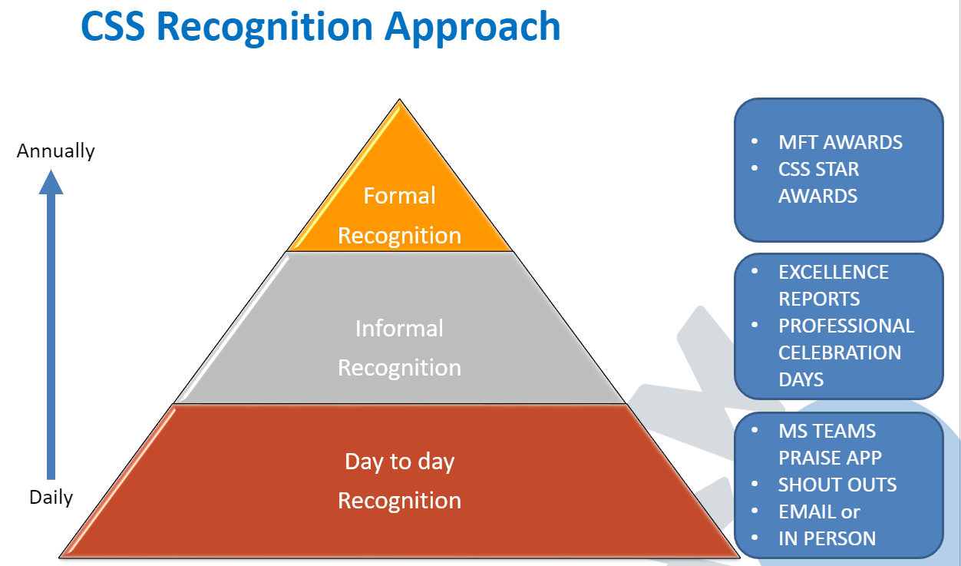

Slide 48


Slide 49
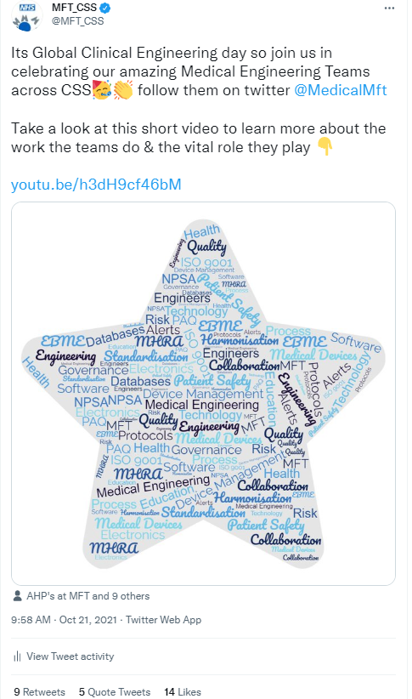
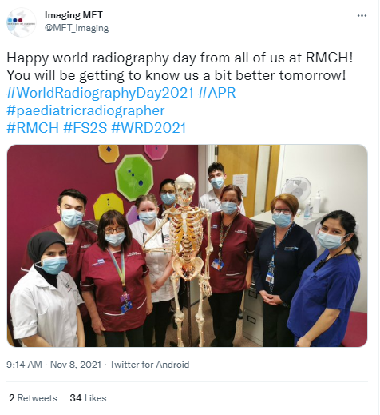
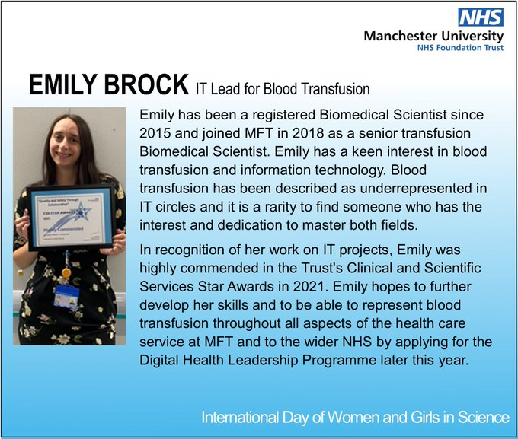
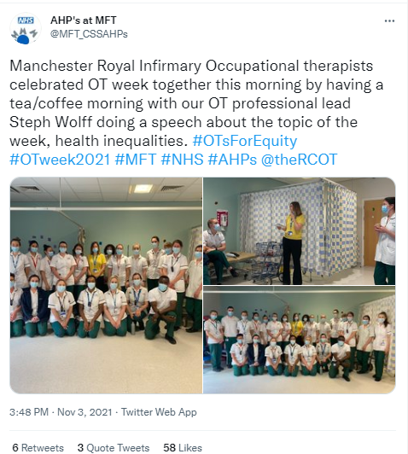
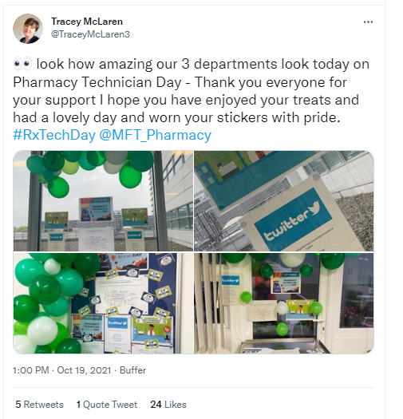
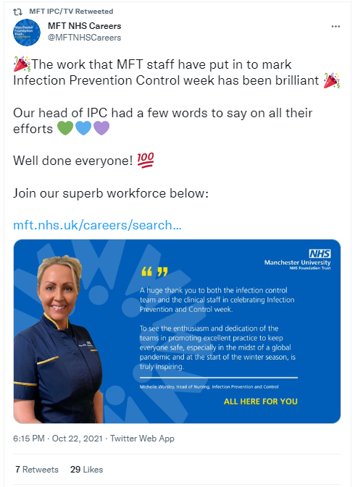
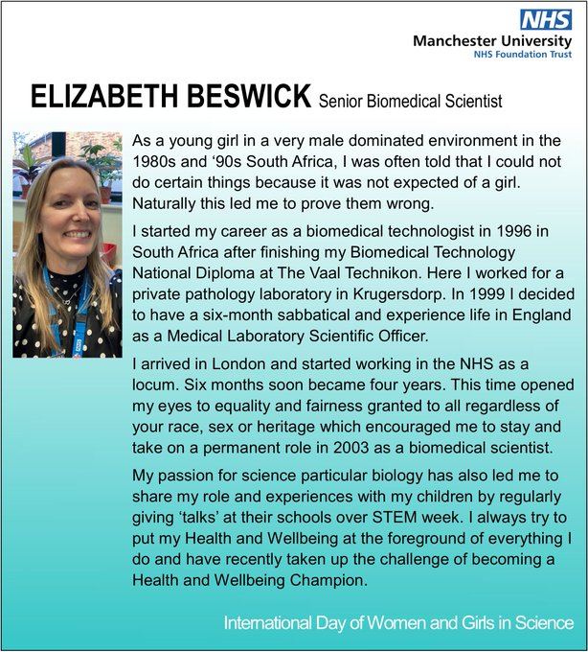

Professional celebration days

Slide 50
Working together

Slide 51
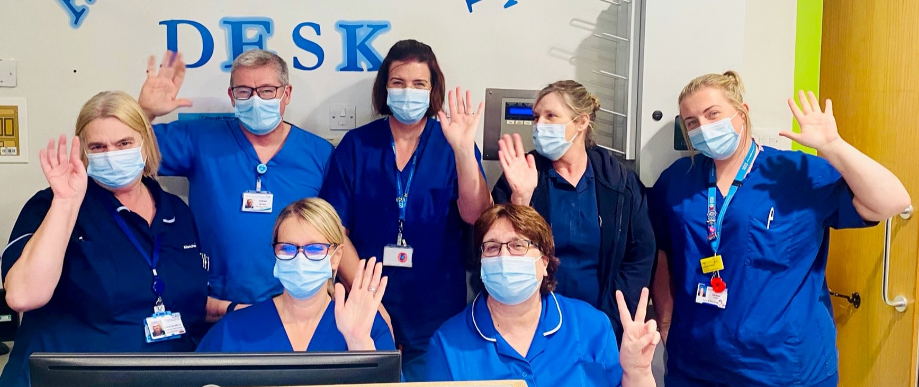
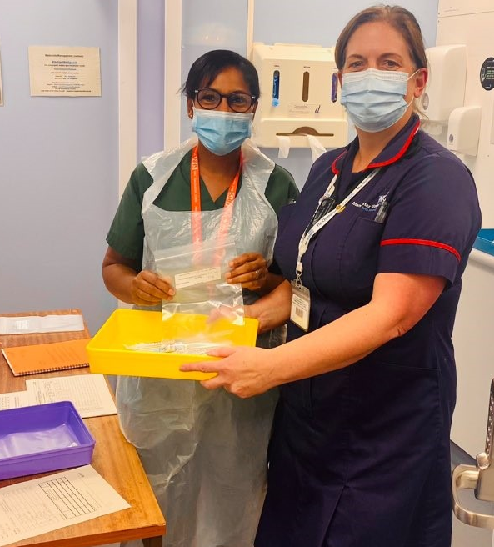
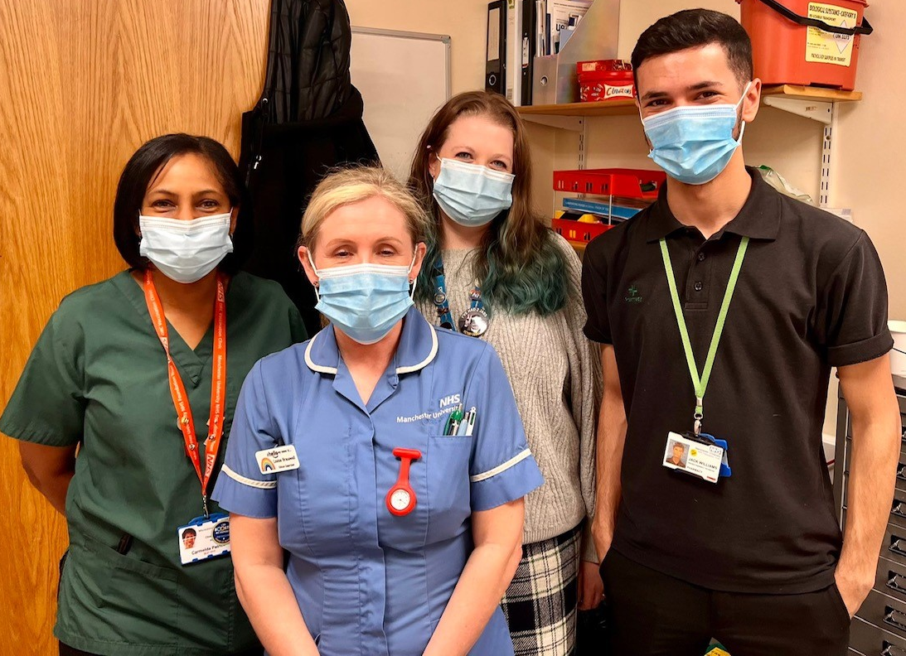
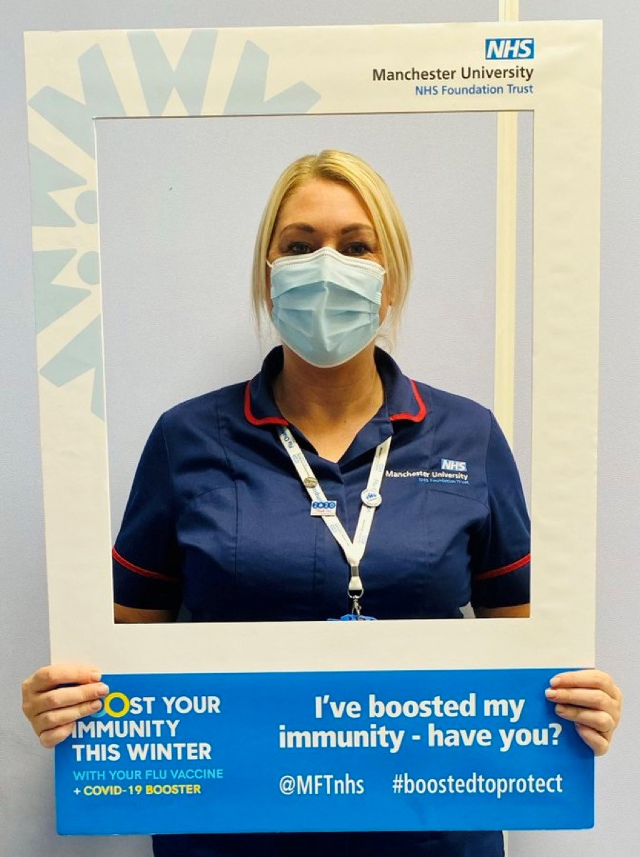
COVID-19 vaccine teams

Slide 52
Dignity and care

Slide 53

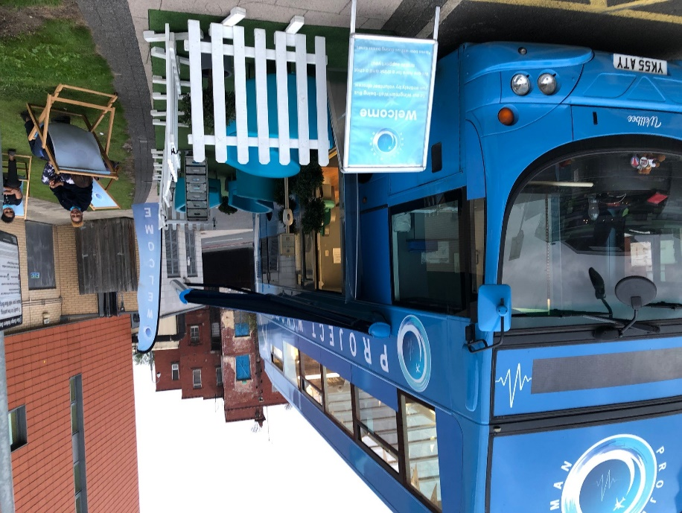
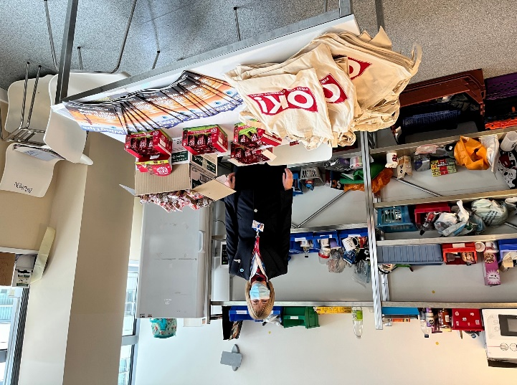
CSS Civility
#CSS_Civility was launched on Patient Safety Day highlighting the direct impact behaviour can have on clinical decision making.
The project had a 4 week launch activity, including the Project Wingman Bus Tour
#CSS_Civilty Social Media Campaign
Linked in with other National campaigns such as Kindness Week etc.

Slide 54
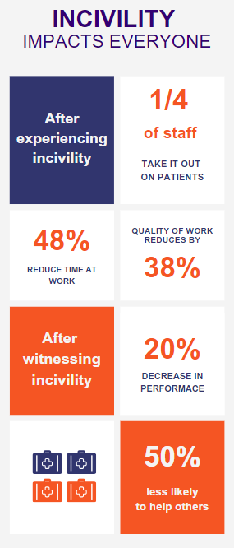
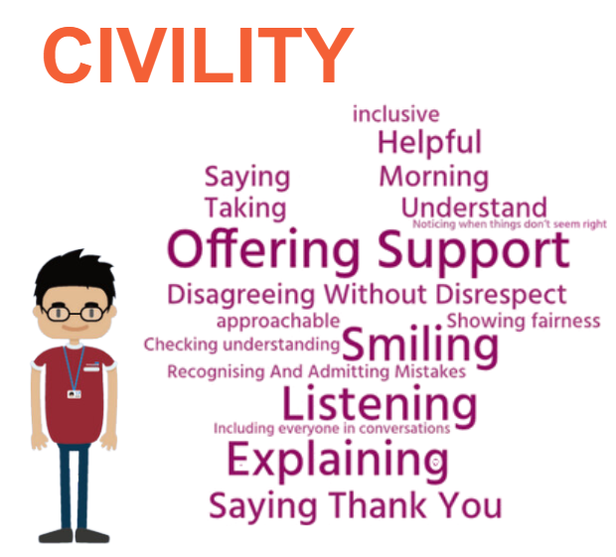
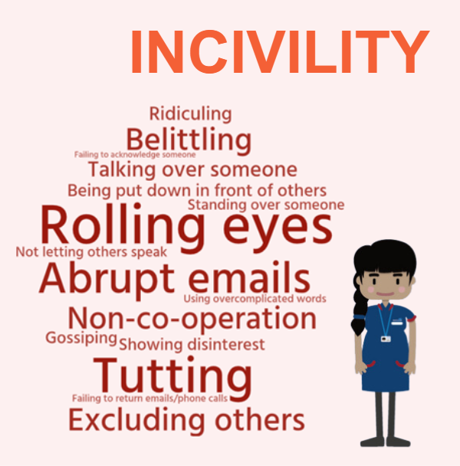

Slide 55
Open and honest

Slide 56
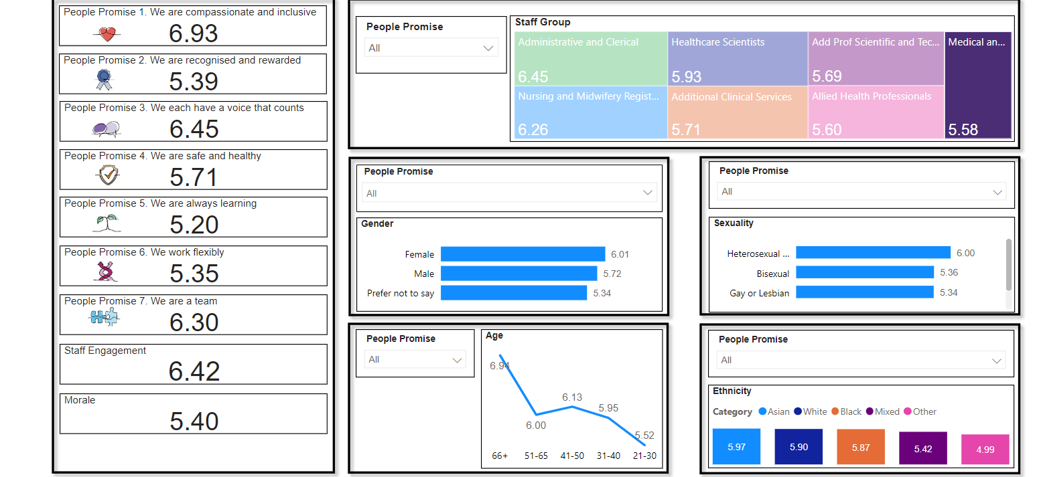
NHS Staff Survey

Slide 57
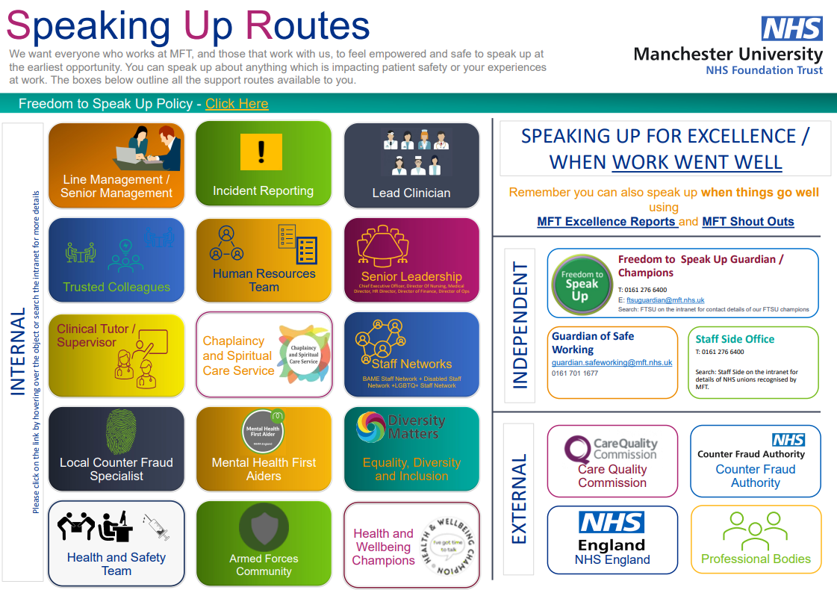

Slide 58
Supporting you

Slide 59
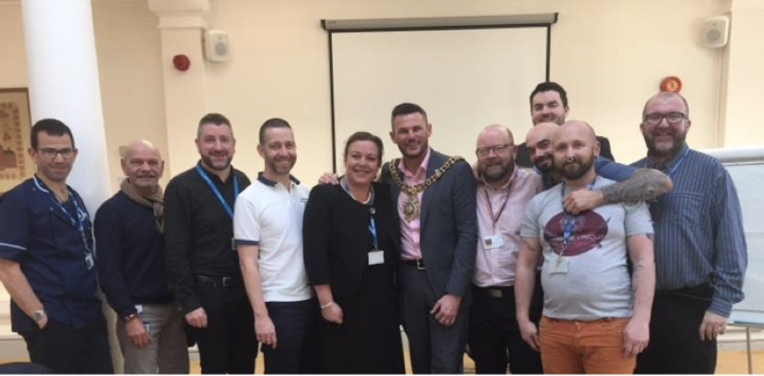



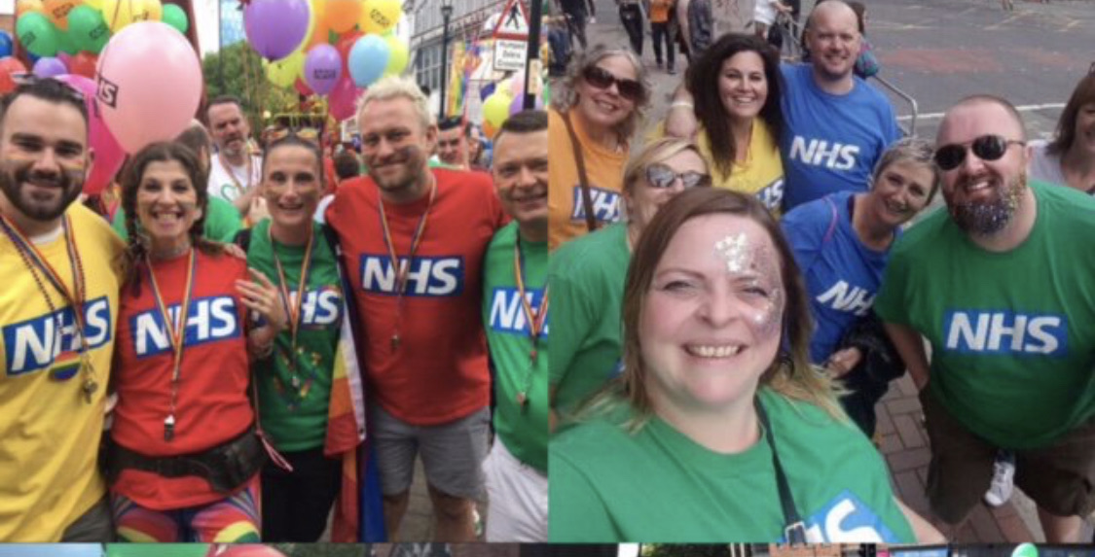

Slide 60
LGBTQ+ Staff Network

Slide 61
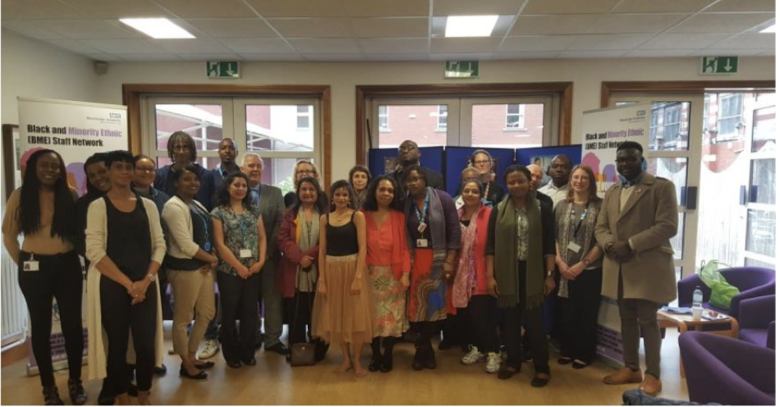
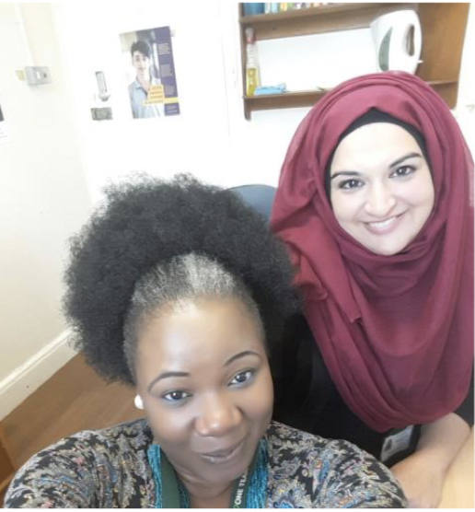
BAME Staff Network

Slide 62
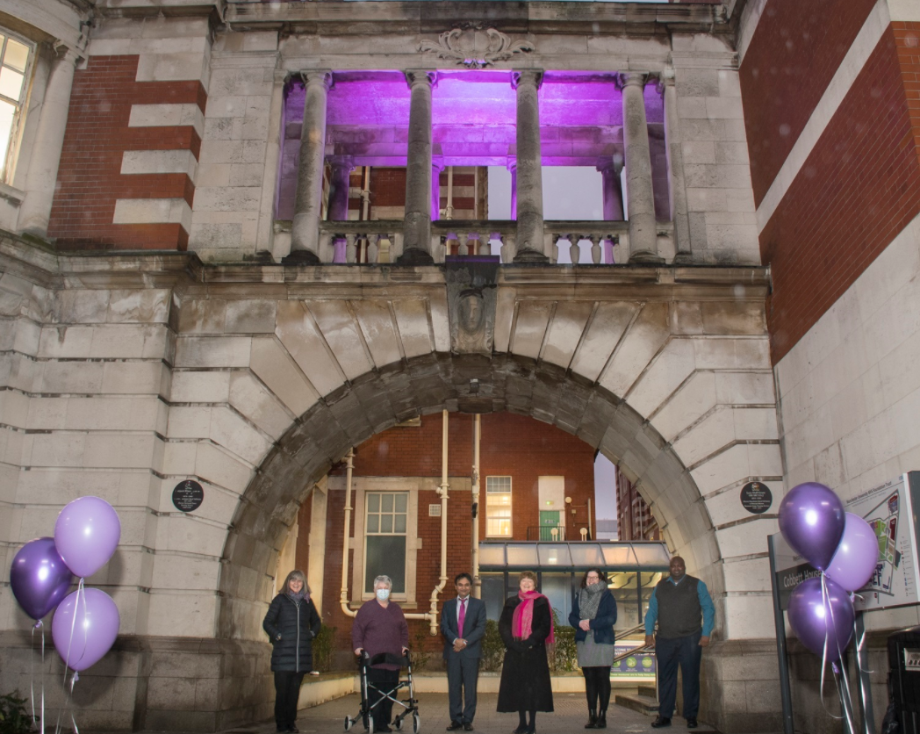

Diverse Abilities Staff Network

Slide 63


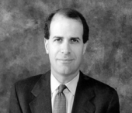
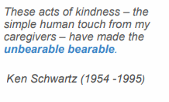

Schwartz Rounds

Slide 64
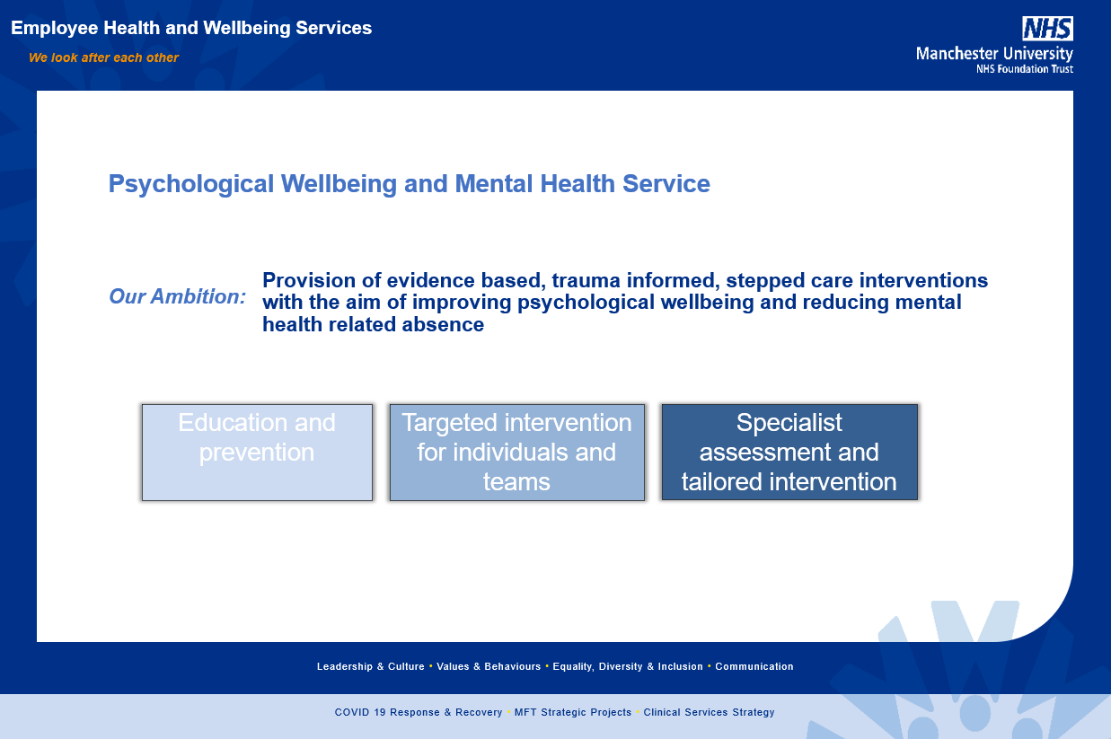

Slide 65
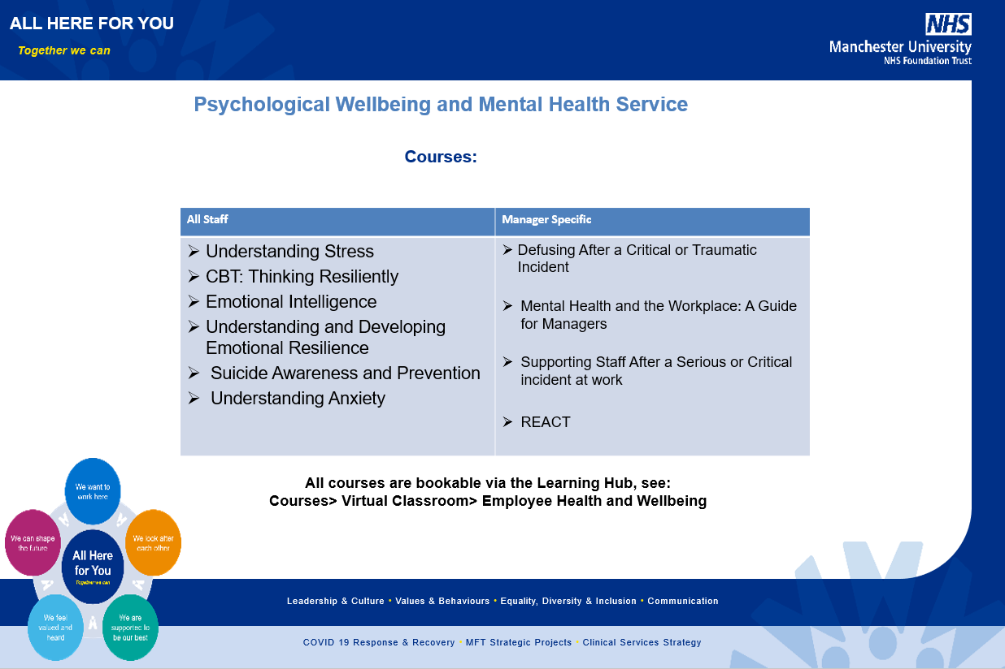

Slide 66
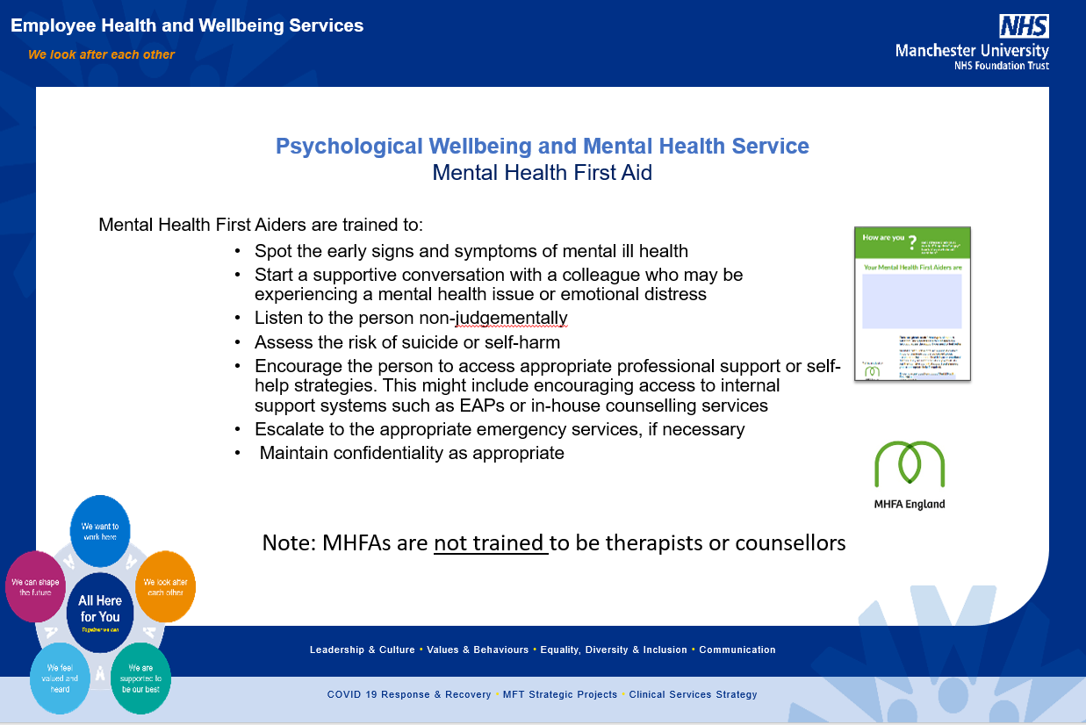

Slide 67


Slide 68


Slide 69
Rewards and benefits

Slide 70










Slide 71


Slide 72


